Slide 1
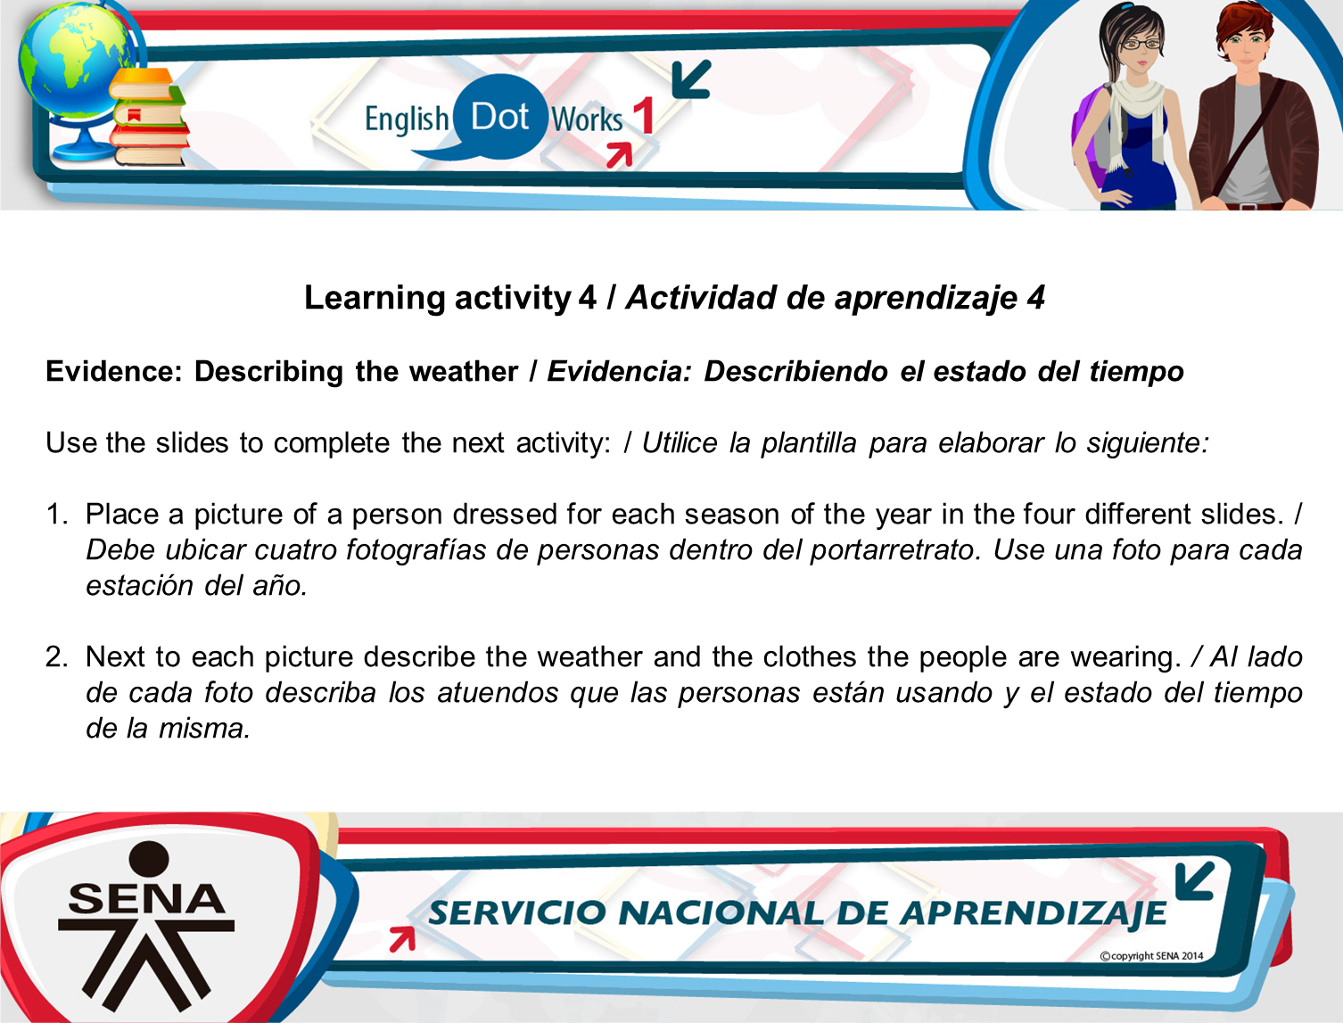


Slide 2
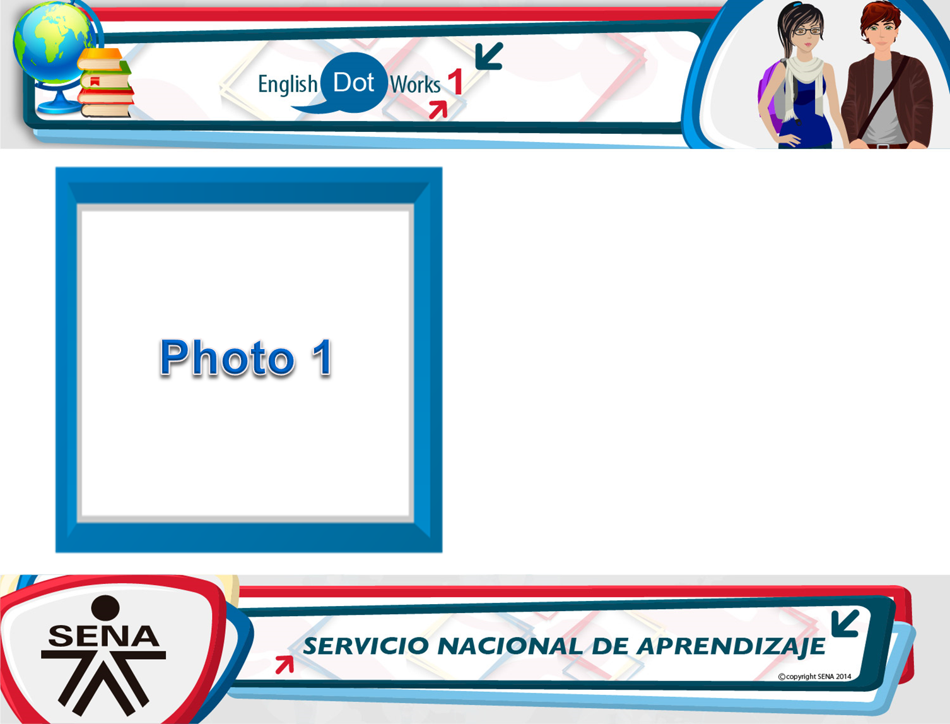
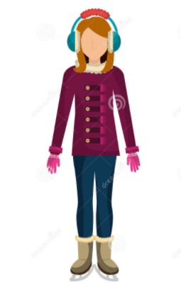
Description of weather and clothes:
The weather of the picture is winter. She is wearing a purple jacket, blue pants, brown shoes and pink gloves.

Slide 3
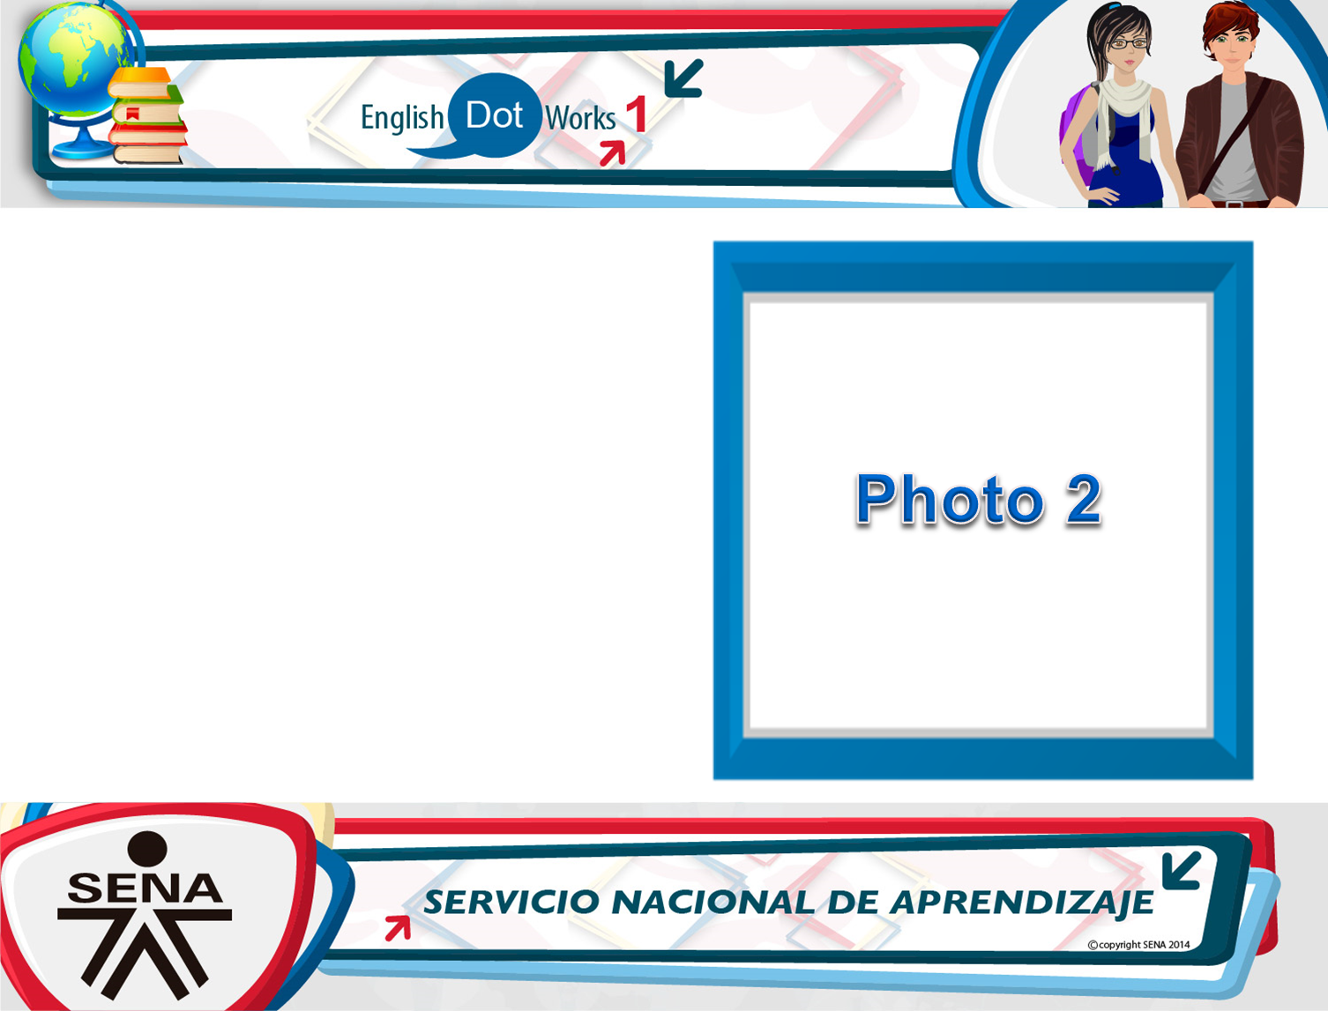
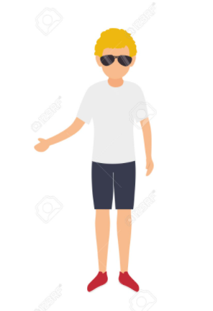
Description of weather and clothes:
The weather of the picture is summer. He is wearing a white t-shirt, a blue short, a red sneakers and sunglasses

Slide 4

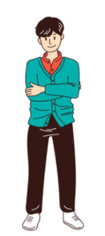
Description of weather and clothes:
The weather of the picture is autumn. He is wearing a blue coat, red t-shirt, black jeans and white sneakers.

Slide 5

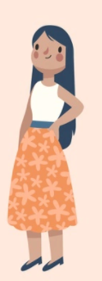
Description of weather and clothes:
The weather of the picture is spring. She is wearing a white blouse, orange skirt whit flowers and black high heels.

Slide 6
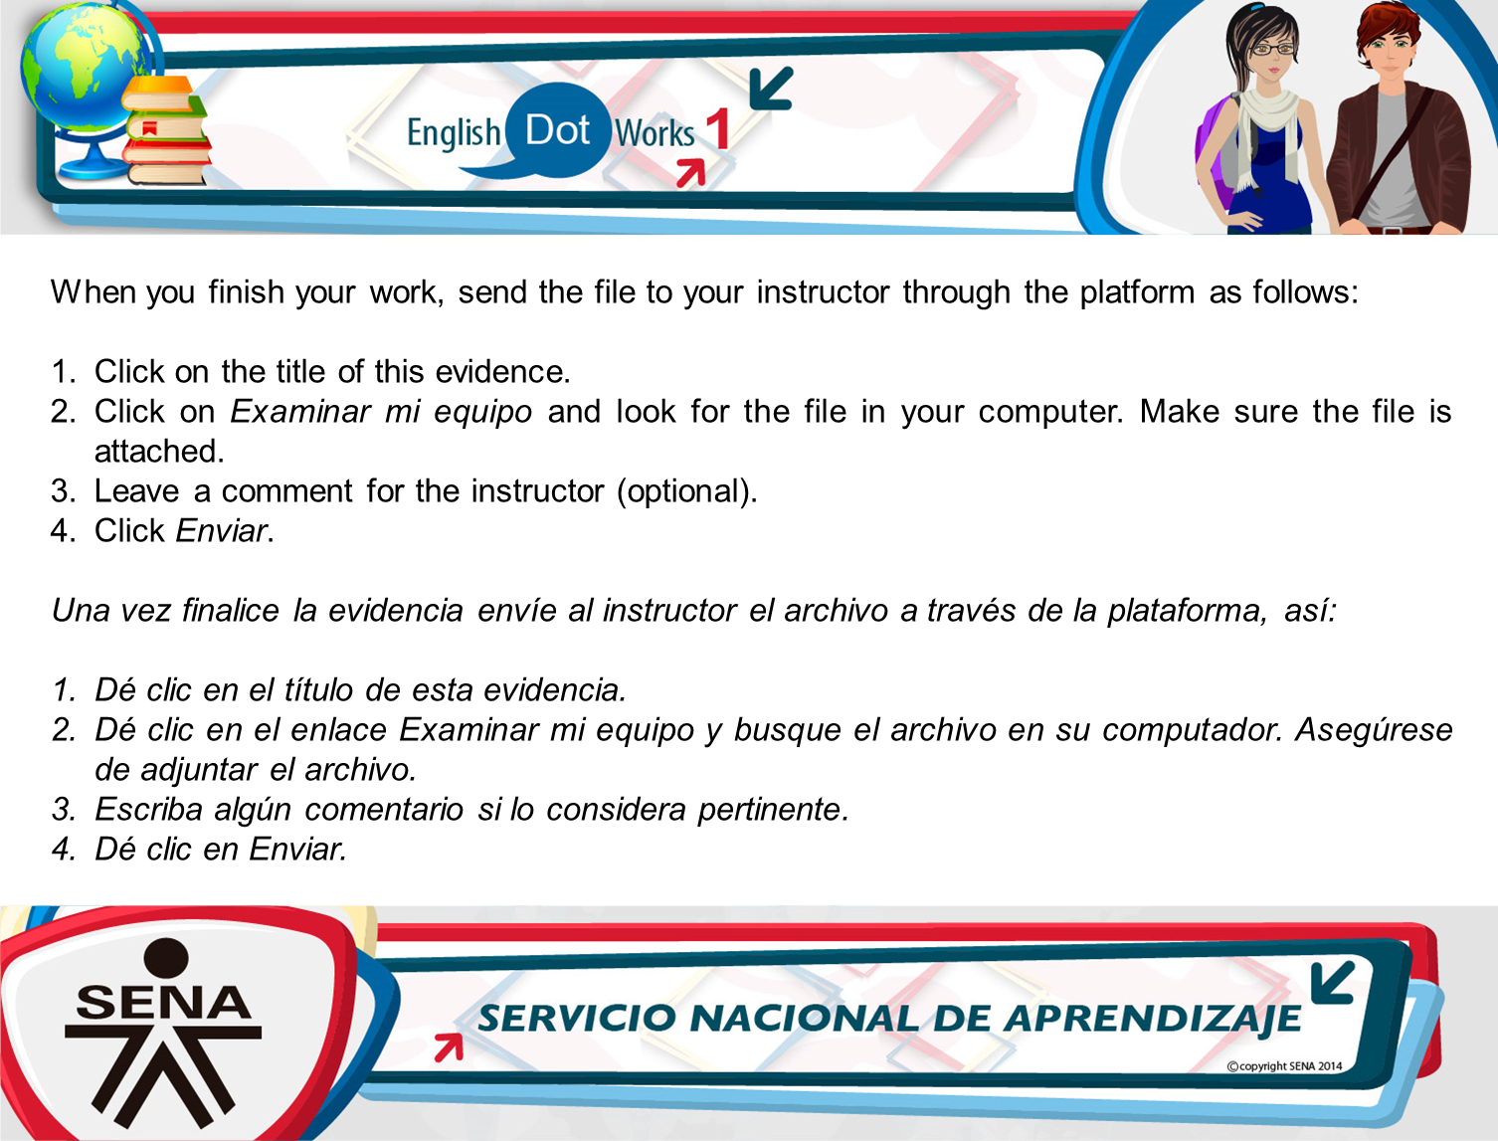
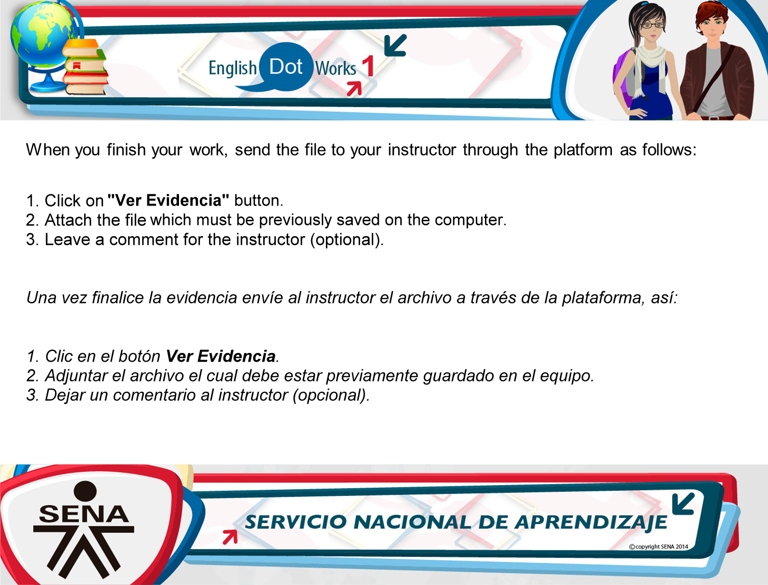
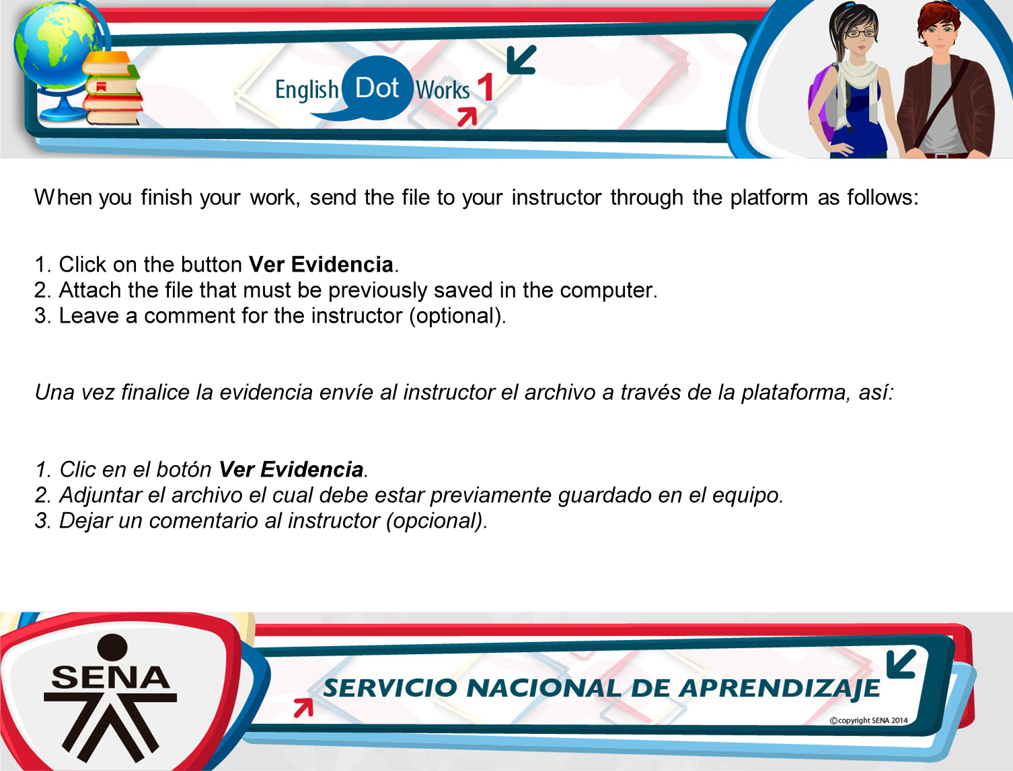

Slide 7
